Slide 1
Experimental aparatus
Cecilia Mageski M Santos

Slide 2
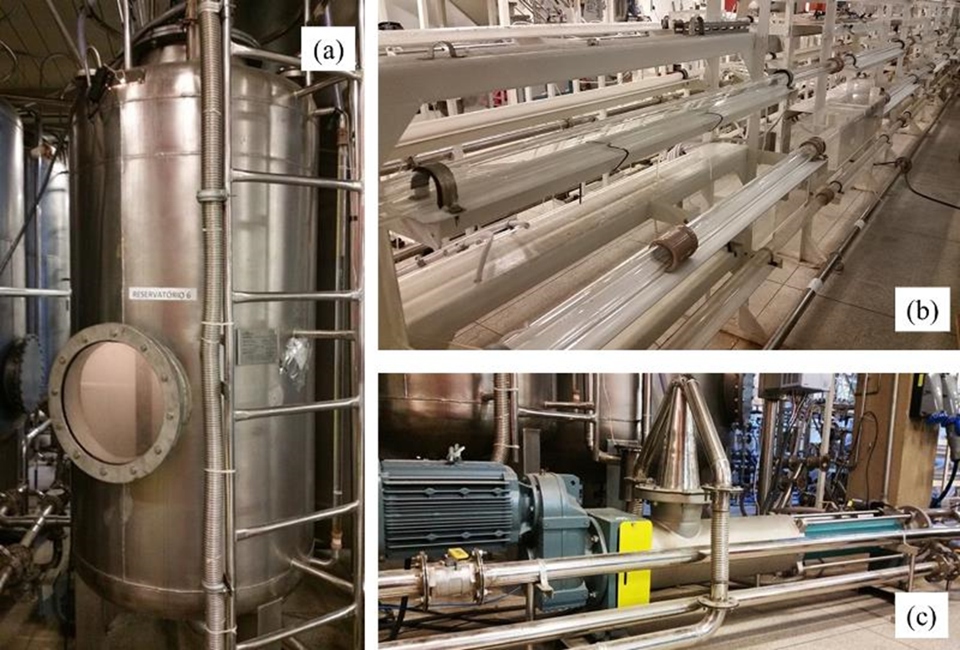
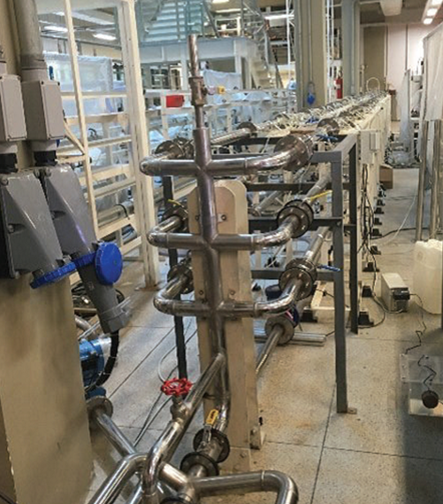
Study of the effect of the polymer in water
The apparatus experimental is made up of 6 closed circuits, built with stainless steel pipes 15 m long and 2 inches in external diameter.
Measurements
Flow rate
Pressure drop

Slide 3
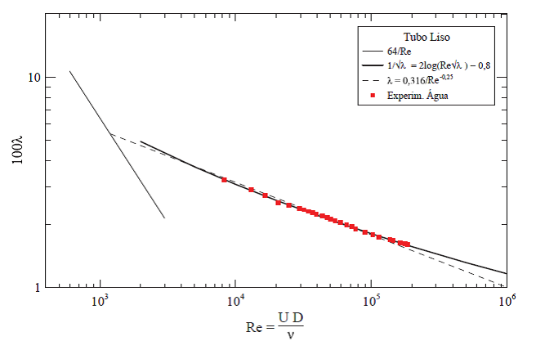
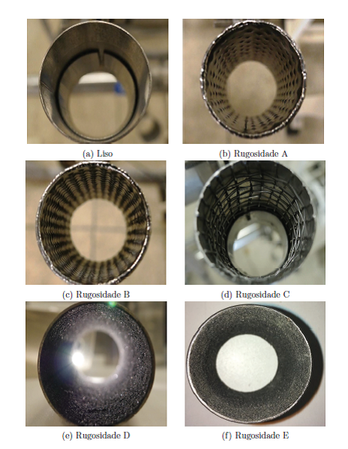
Smooth and roughness surfaces for water
Smooth pipe

Slide 4
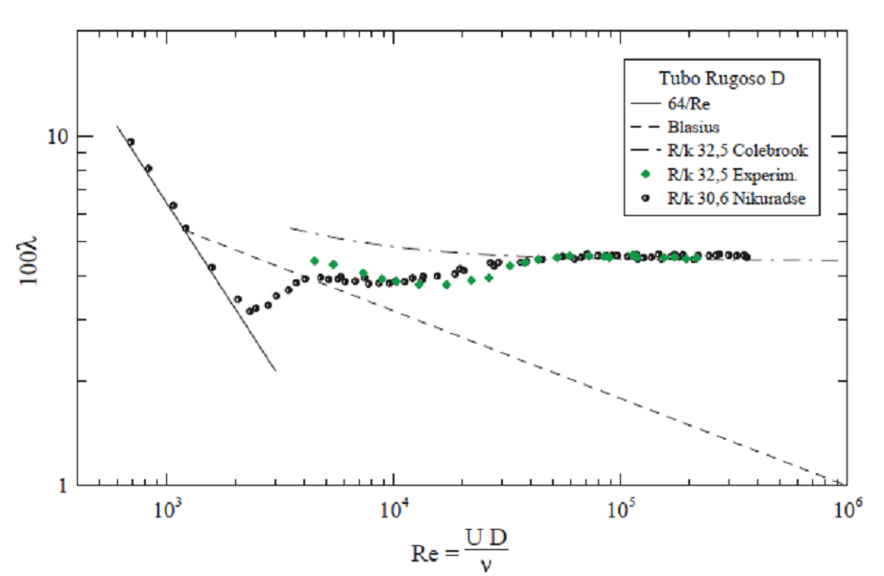
Smooth and roughness surfaces for water

Slide 5
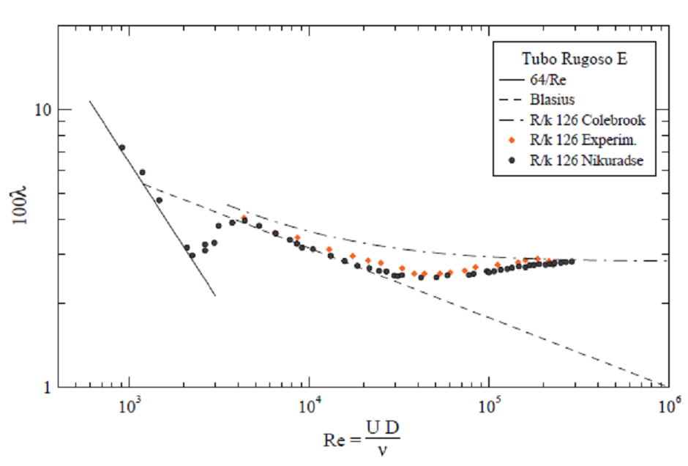
Smooth and roughness surfaces for water

Slide 6
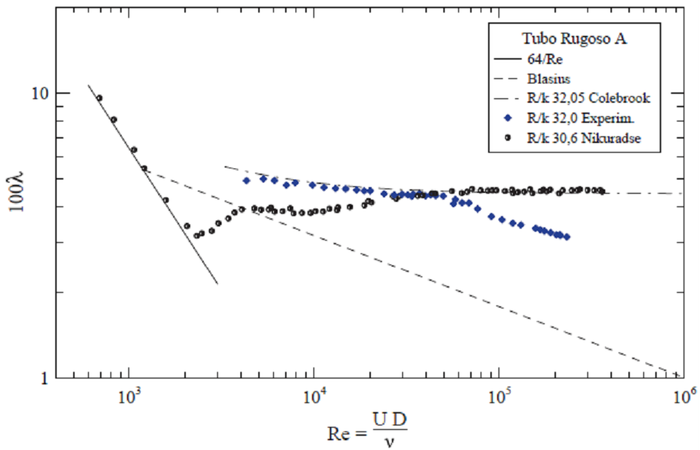
Smooth and roughness surfaces for water

Slide 7
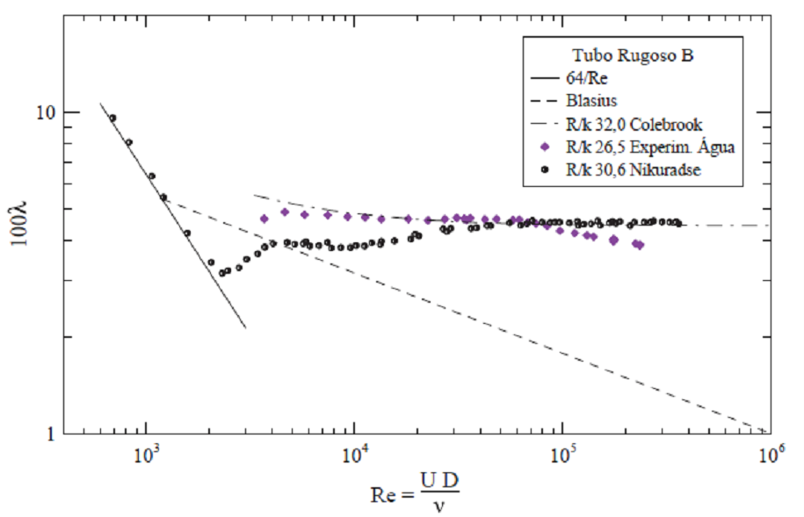
Smooth and roughness surfaces for water

Slide 8
Smooth and roughness surfaces for water
Roughness
Smooth

Slide 9
Smooth and roughness surfaces for water with polymer
Smooth pipe
Polymer – CMC – concentration 0,1%
The fluid rheology was monitored
The influence of the temperature was verify and the temperature was monitored
Smooth pipe

Slide 10
Smooth and roughness surfaces for water with polymer
Roughness pipe D
Polymer – CMC – concentration 0,1%
The fluid rheology was monitored
The influence of the temperature was verify and the temperature was monitored
Roughness pipe

Slide 11
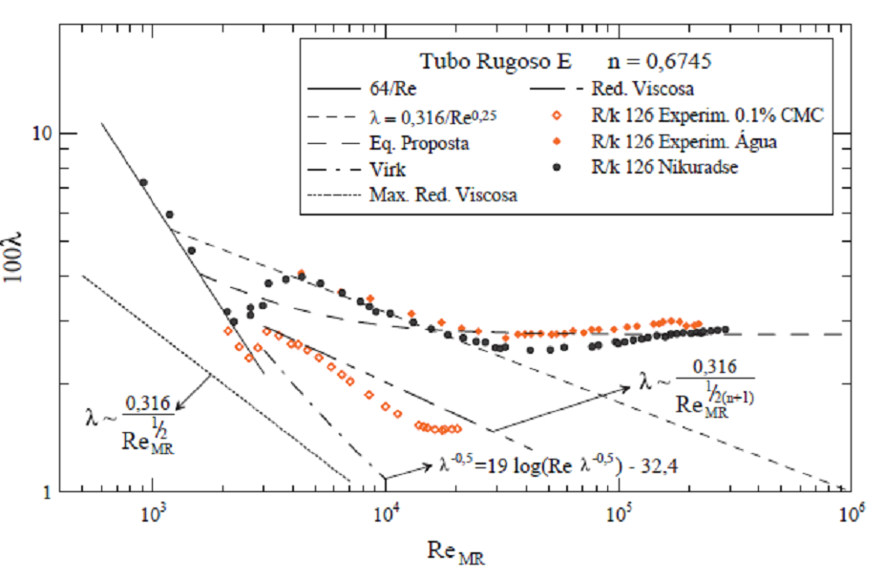
Smooth and roughness surfaces for water with polymer
Roughness pipe E
Polymer – CMC – concentration 0,1%
The fluid rheology was monitored
The influence of the temperature was verify and the temperature was monitored
Roughness pipe

Slide 12
Smooth and roughness surfaces for water with polymer
Roughness pipe A
Polymer – CMC – concentration 0,1%
The fluid rheology was monitored
The influence of the temperature was verify and the temperature was monitored
Roughness pipe

Slide 13
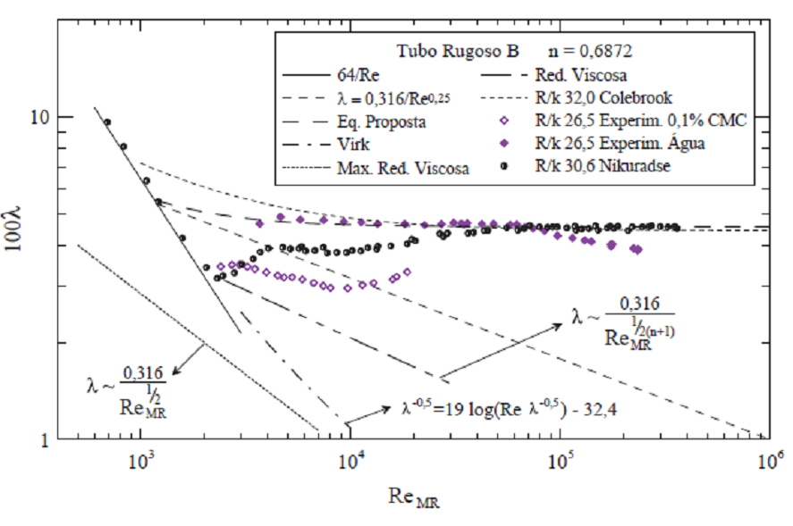
Smooth and roughness surfaces for water with polymer
Roughness pipe B
Polymer – CMC – concentration 0,1%
The fluid rheology was monitored
The influence of the temperature was verify and the temperature was monitored
Roughness pipe

Slide 14
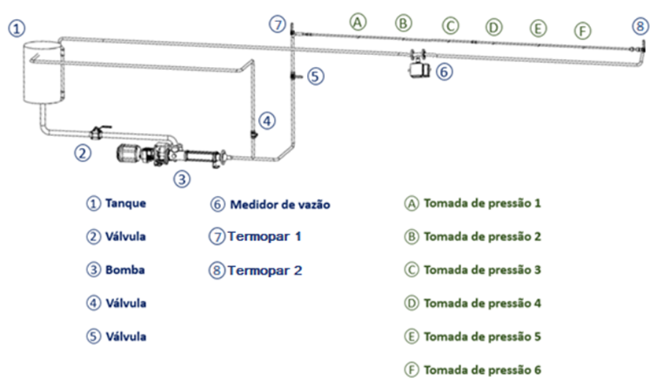
Study of the effect of the polymer in oil
Acrylic Pipe
Smooth pipe
Approx. 6 meters
Tank 70 liters
Two polymers
Difference is molar mass (1g/mol – 4g/mol)
Tank
Valve
Pump
Valve
Valve
Flow rate
Termocouple
Termocouple

Slide 15
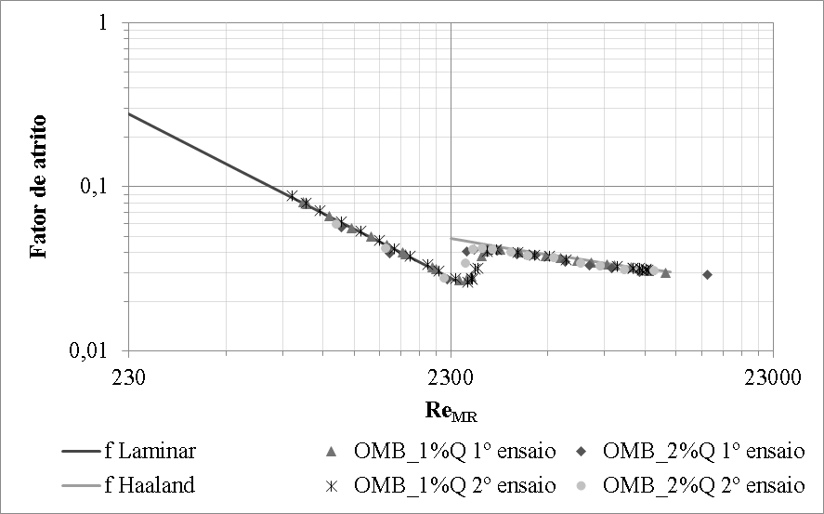
Study of the effect of the polymer in oil
Friction factor for oil with solvent
Two concentration of solvent
The rheology is verified and monitored
Temperature is monitored, and verified.

Slide 16
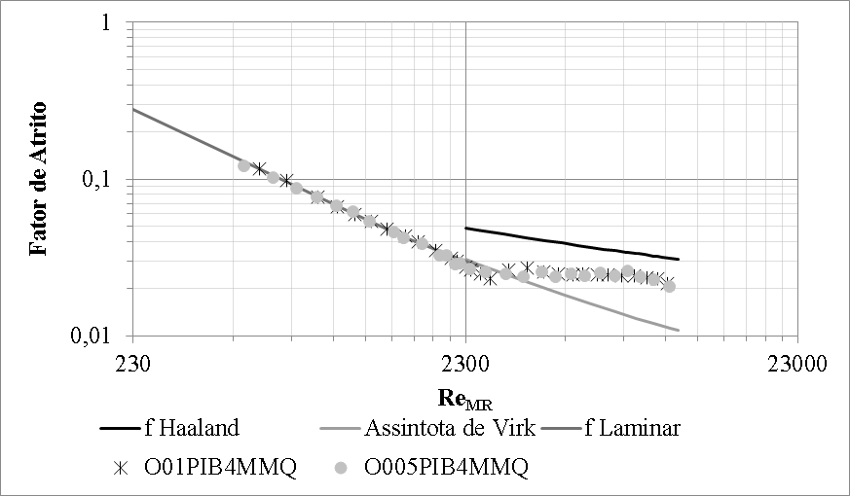
Study of the effect of the polymer in oil
Friction factor for oil with solvent
Polymer is PIB in two concentration
The rheology is verified and monitored
Temperature is monitored, and verified.

Slide 17
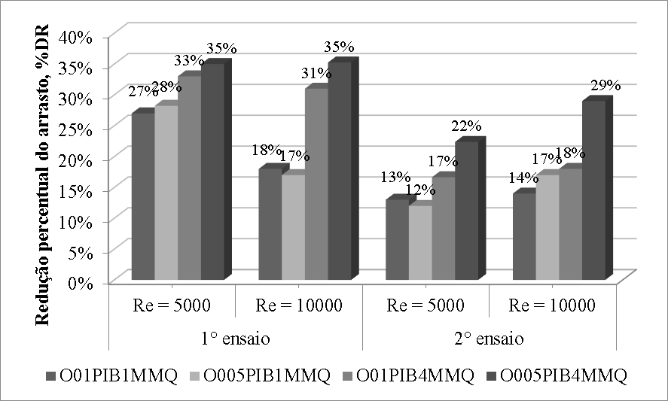
Study of the effect of the polymer in oil
Friction factor for oil with solvent
Polymer is PIB in two concentration
The rheology is verified and monitored
Temperature is monitored, and verified.
Degradation is observed when we increase Reynolds numbers

Slide 18
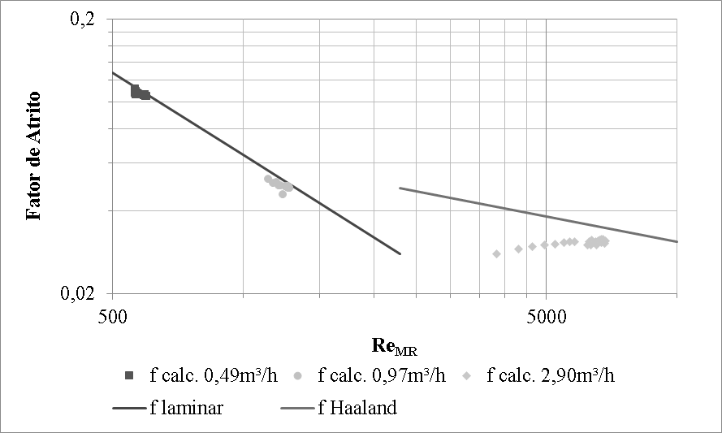
Study of the effect of the polymer in oil
Degradation in turbulent flow
Test is to monitor pressure drop over time
We can see that in turbulent region the degradation is instantaneous

Slide 19
Biphase flow (liquid-gas)
Equipment
Acrylic Pipe: 44,2mm ID (b)
12m lenght
Reservoir of 1m³ with agitator (a)
Air compressor
Pump (c)

Slide 20
Study of the effect of the polymer in biphase flow (liquid-gas)
Degradation in turbulent flow
Test is to monitor pressure drop over time
We can see that in turbulent region the degradation is instantaneous

Slide 21
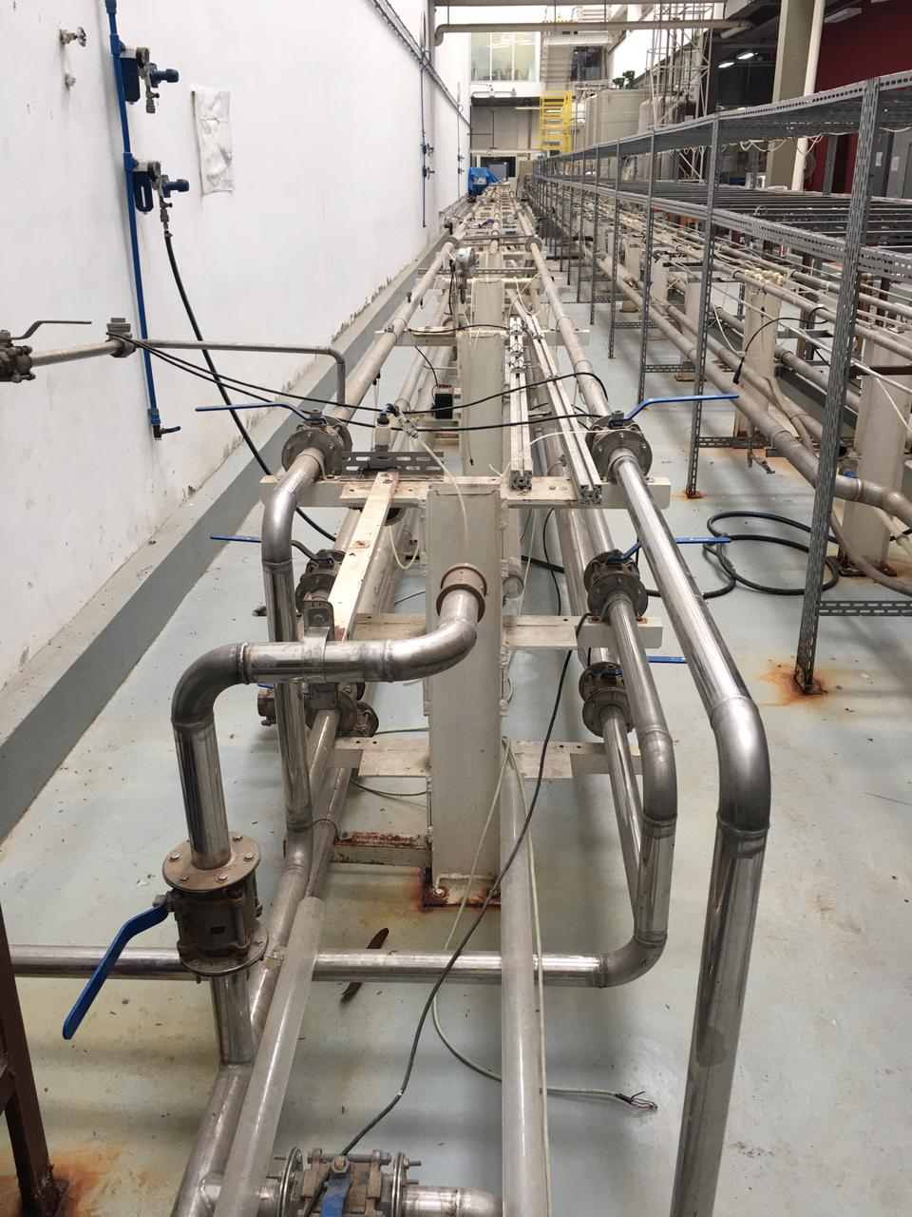
Capacit install
Steel pipe, with +/- 30m of length
Pump of the 20 and 40 m³/h
Electromagnetic flow rate (check)
Differential and absolute pression gate
Manometer
Gas flow rate type vortex (Check)

Slide 22
ESTER Aparatus
Steel pipe, with +/- 30m of length
Pump of the 20 and 40 m³/h
Electromagnetic flow rate (check)
Differential and absolute pression gate
Manometer
Gas flow rate type vortex (Check)

Slide 23
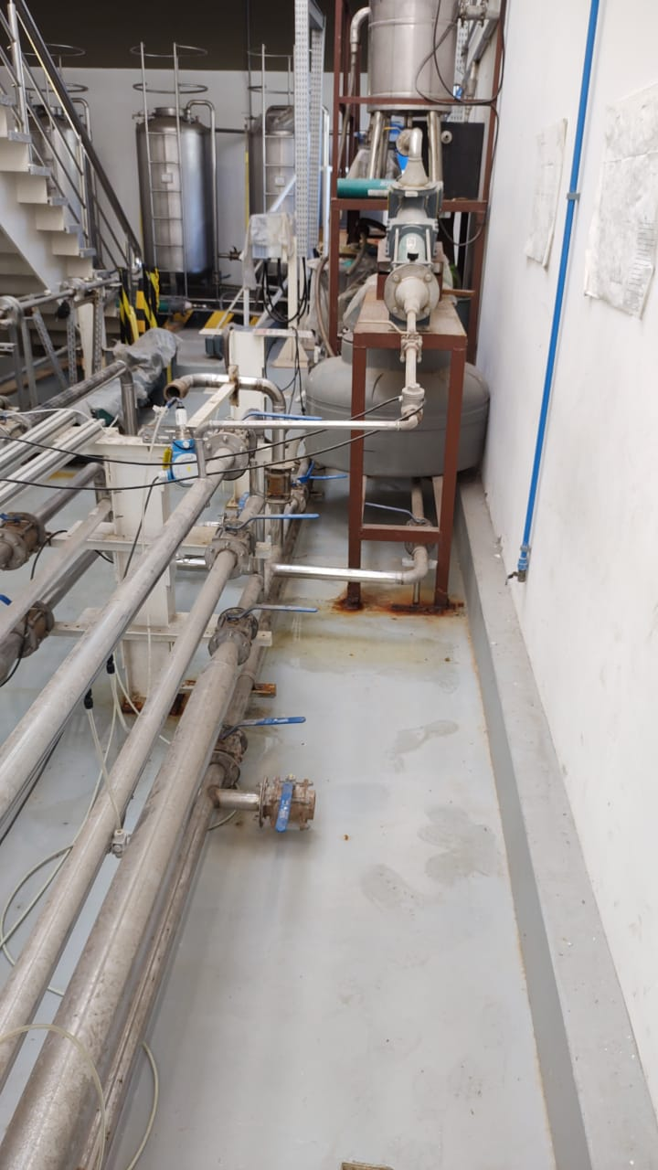
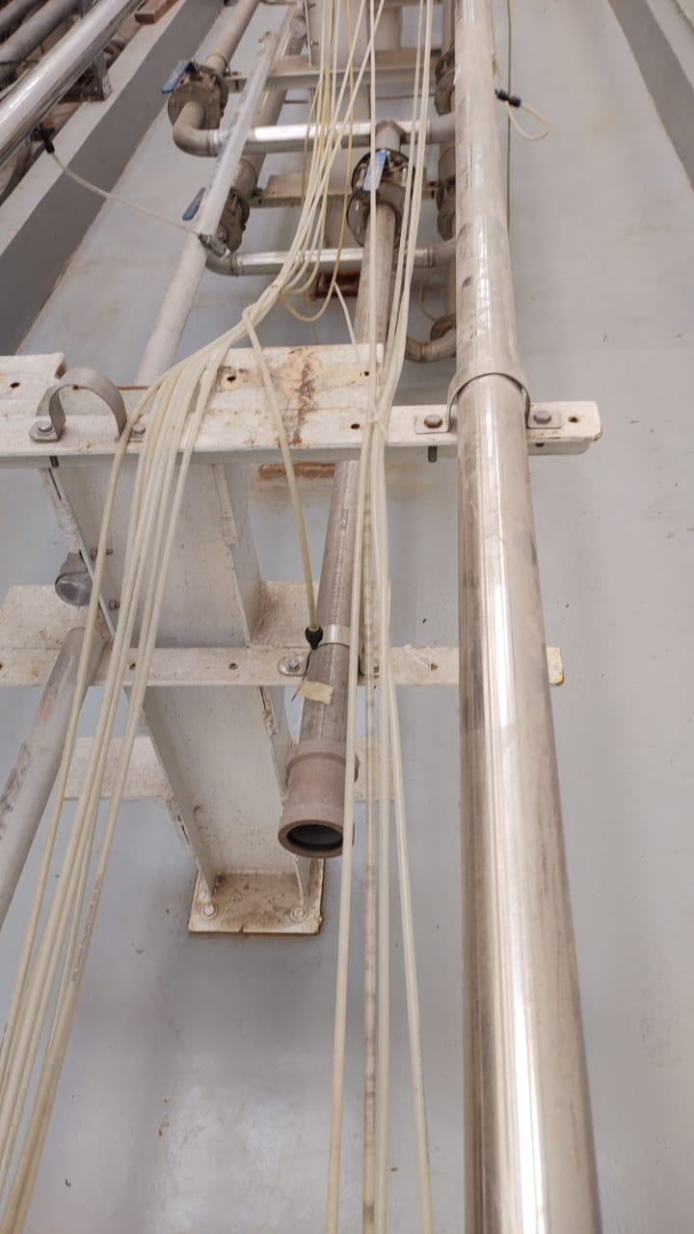
Fisic Area
What we have to do...
First - we have to clean the area of the experiment because it is uninhabitable..
To buy crystal pipes for pression dot

Slide 24
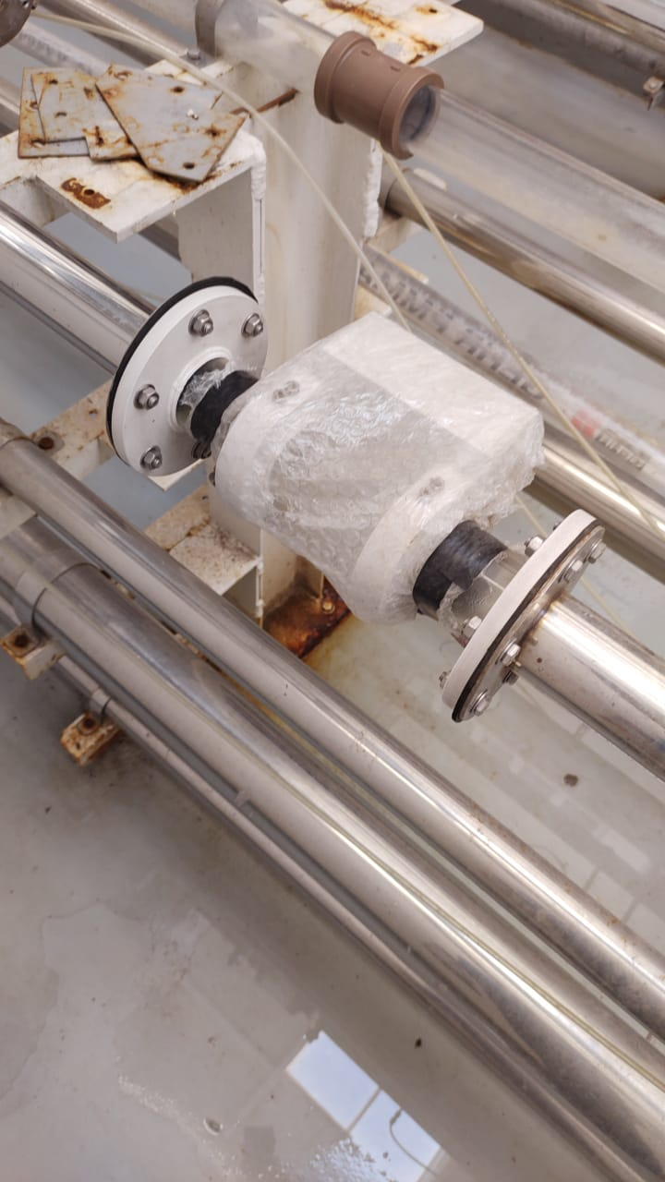
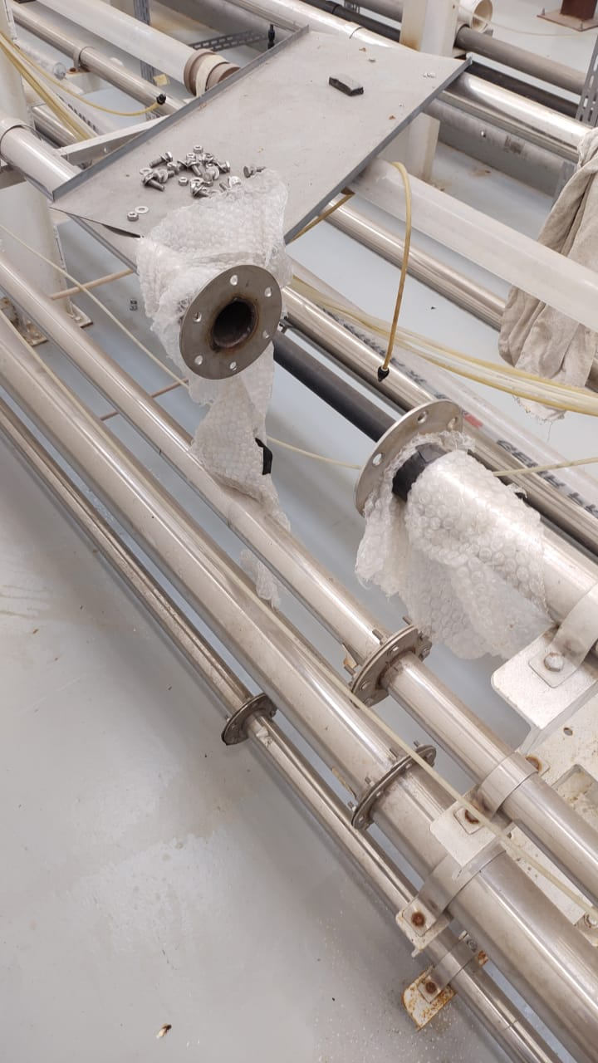
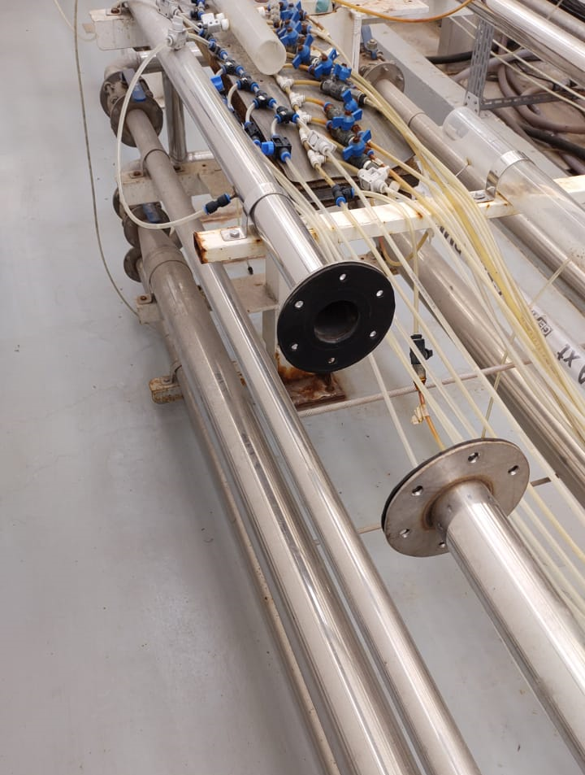
Experimental aparatus
What we have to do...
We have 4 resistive sensors of gas fraction.
Close the pipe.. Because two sensors was removed of the RIG. (guess who…? rsrsrs)

Slide 25
Fisic Area
We need buy a new computer because what we had is not working.
I prefer to buy a notebook, the price is the same and more easy to save.

Slide 26
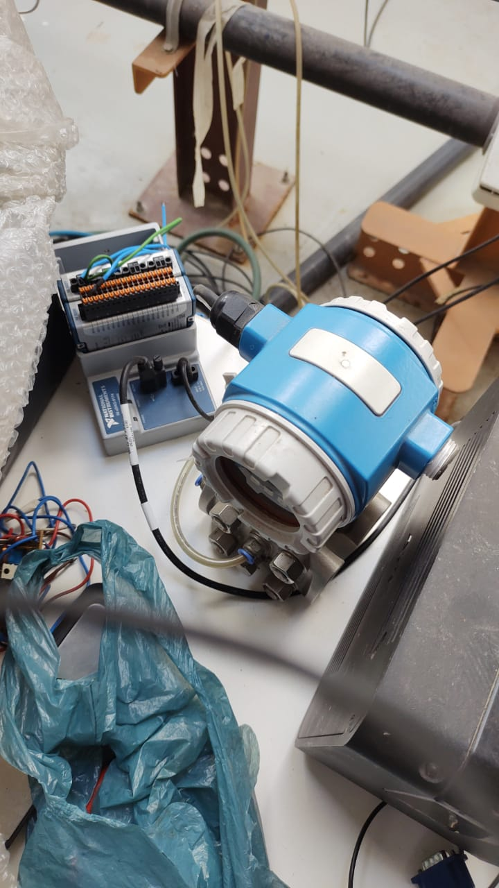
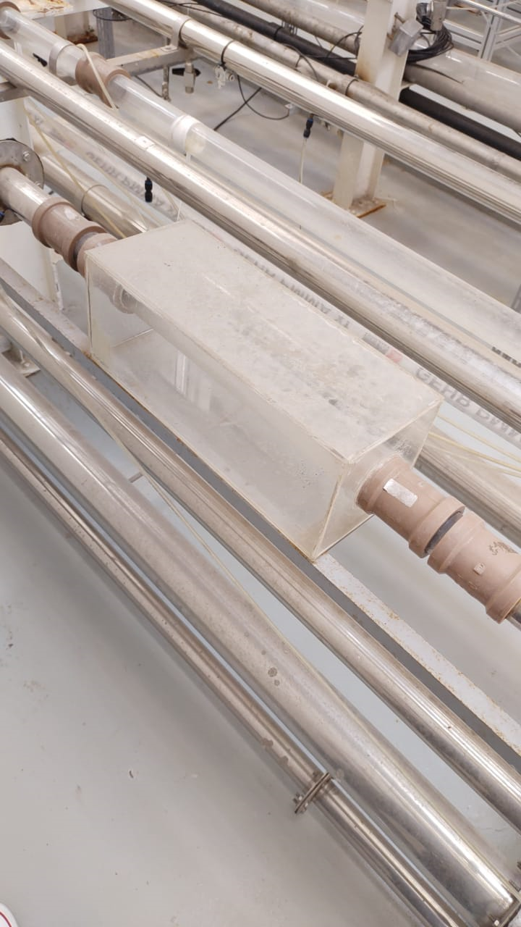
Fisic Area
What we have to do...
We need to buy / or to do a new acrylic/glass section for to view flow pattern.
Install the system of the data acquisition that isn’t work.

Slide 27
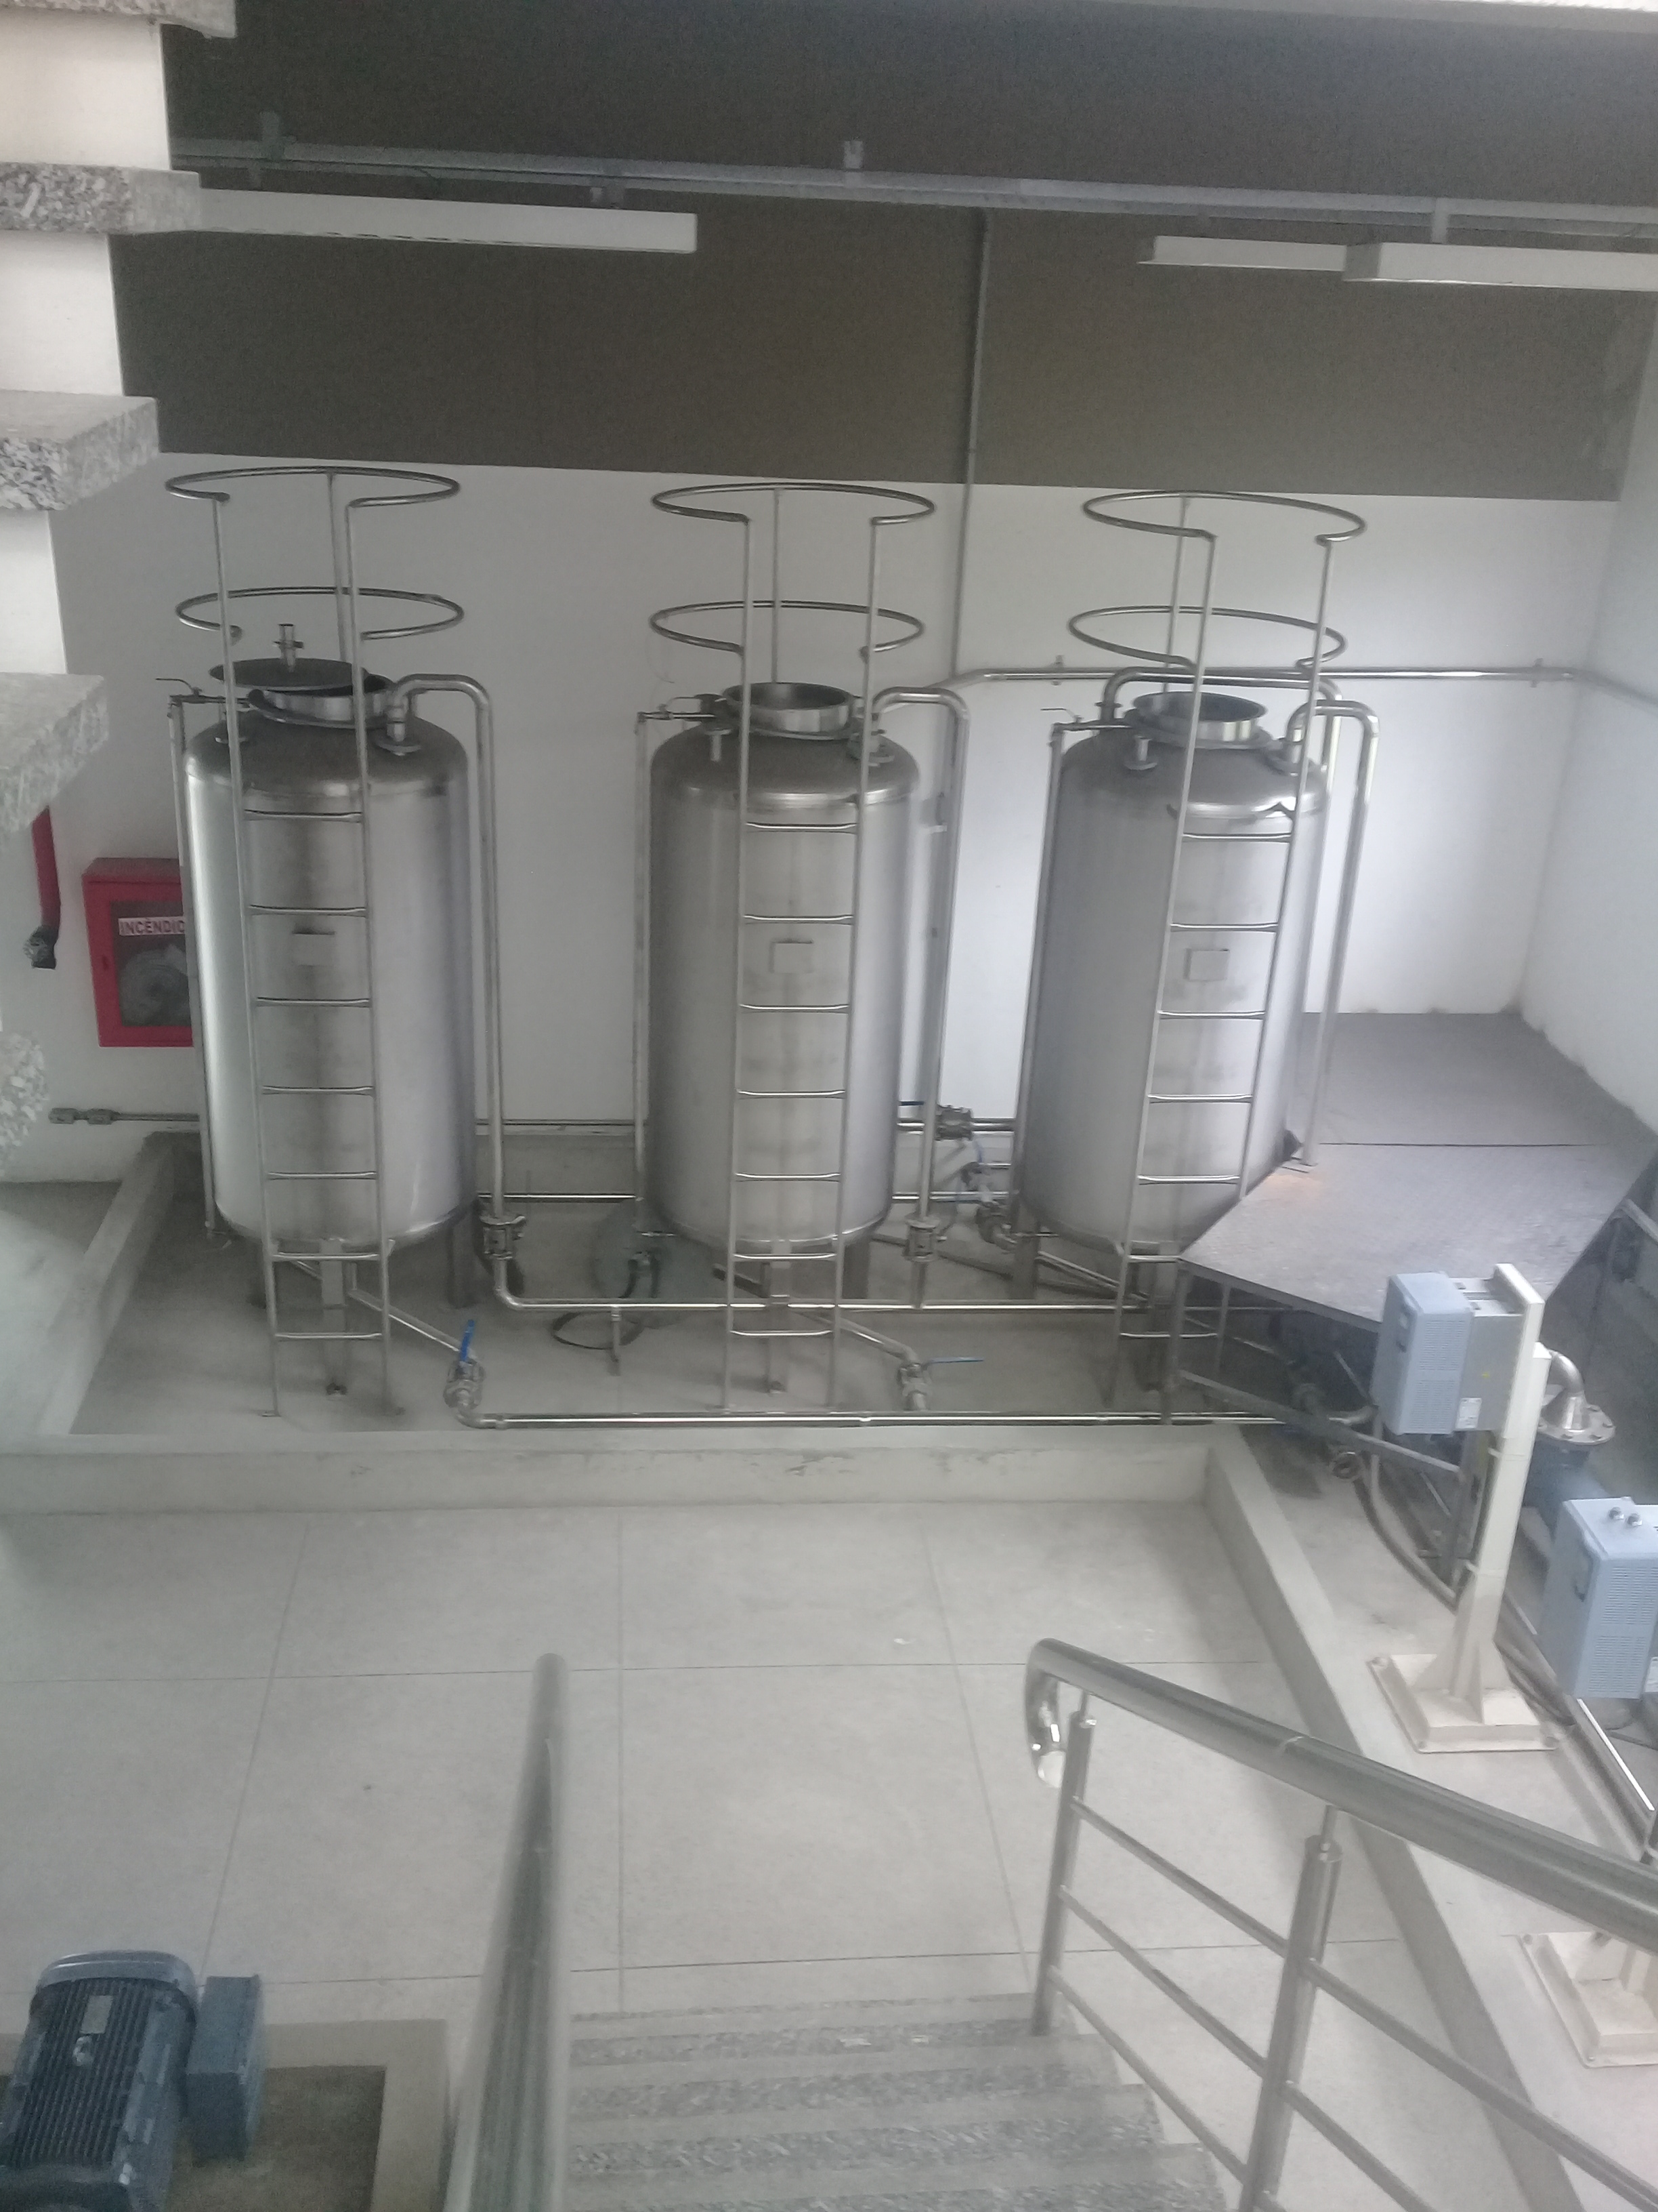
Fisic Area
What we have...
Three Tanks of the 1000l
One tank is full of oil and we have discard this oil correctly.
I suggest to change one tank for one of 4000l. Because the suction region of pump is not influenced for the return of fluid of the pipe. Principally when we have with biphasic flow, and we need separated the phases before of the pump suction.

Slide 28
Experimental Aparatus

Slide 29
Pictures of the aparatus

Slide 30
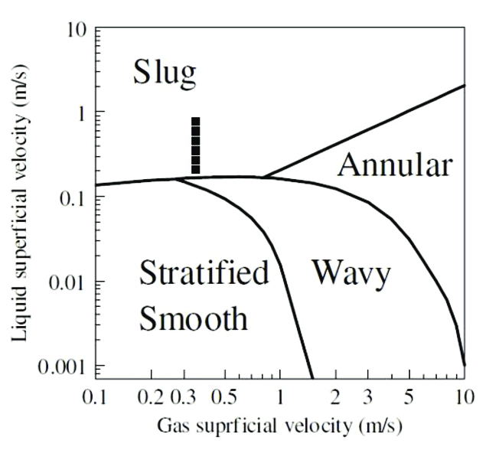
What we can mesuriment
Liquid and gas flow rate
Velocity
Reynolds
Friction factor
Slug sensor
Frequency bubble/slug
Velocity slug
Bubble length
Piston length
Pressure drop
Friction factor
Viewer flow pattern
Flow pattern map

